Slide 1
BIKE BUYERS DATA ANALYSIS

Slide 2
introduction
The project provides the overview of bike buyers data throughout the year.
The data mainly focus on columns like Gender, Age, Occupations etc
Finding and clearing of null values, duplicates
Drawing the visualizations of data
Retrieve some conclusions from graphs

Slide 3
Modules used
NUMPY
PANDAS
MATPLOTLIB
SEABORN

Slide 4
ANALYSIS
Import the dataset
Read dataset
Find the null values and handle it
Find and remove the duplicates
Create a new column from existing column.
Rechange the dataset

Slide 5
Visualization
Import Matplotlib
Draw a histogram using Age column
Draw a Pie chart for Gender column
Draw a bar graph for Occupation column

Slide 6
Functions used
To read the data( read_csv(df))
Info() #gives columns details
Describe # to know statistical data
Fillna() # to add value for numerical data
Dropna() # To remove null valued rows

Slide 7
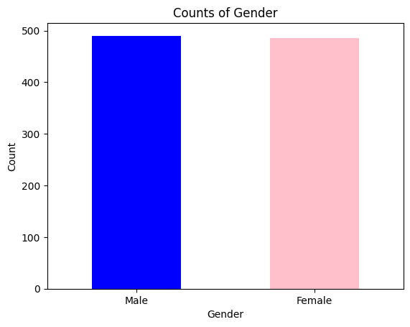
Bar graph
The following the figure shows the bar graph which shows the number of male and female candidates who bought the bikes.
The plotting is done by taking the counts on y-axis and gender on x-axis.
The labels are provided using xlabel and ylabel.
Conclusion:
The number of males and females who are using the bikes is almost same(males>females) as per the data.The original may vary slightly.

Slide 8
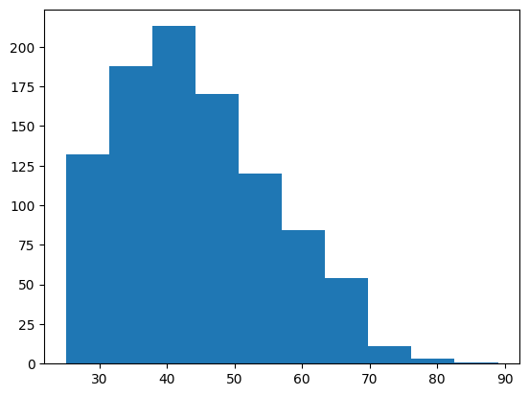
Histogram
The following histogram shows the distribution of peoples age.
The following the histogram shows that the more number of people who are using the bikes are in the range of 30 to 50.
The graph shows the plot for ages in x-axis.

Slide 9
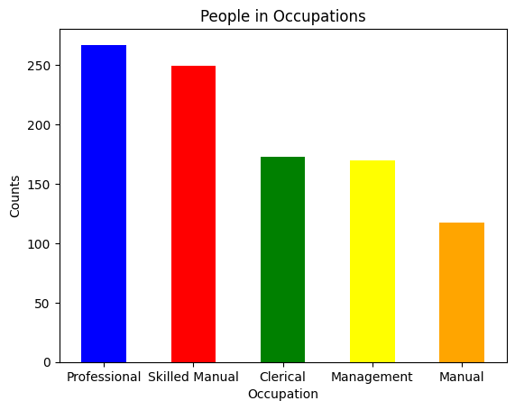
Bar graph
The bar graph here shows the relation between number of people and occupation.
The number of people are mostly employed in the professional and then skilled manual.
The minimum people are employed in the manual work.

Slide 10
Conclusions
The number of males and females using the bikes are almost same.
The age groups using bikes are more between the ages 30 to 50.
The number of people who are using the bikes are mostly professional and slightly for manual works.
LINK:
Link_to_project0

Slide 11
Thank You

